Slide 1
Team 7
Open IIT Data Analytics

Slide 2
Introduction

Slide 3



Problem Overview
Popularity
Revenue
Constrain
Developing a ML pipeline for predicting popularity of a music label
Bidding an amount such that the losses faced are minimal i.e. maximizing revenue
Bidding is successful only if we bid more than or equal to. the expected value of a label
Notes:
The problem statement states to maximize the revenue of the predicted popularity of songs. The dataset provided consists of 12227 data points with 17 columns. The 16 independent variables are useful in the prediction of the dependent target variable, popularity.Based on the prediction of the music, a bid is made along with a specified expected revenue from the same. The main focus is to maximize this revenue collected in total from all the songs.

Slide 4
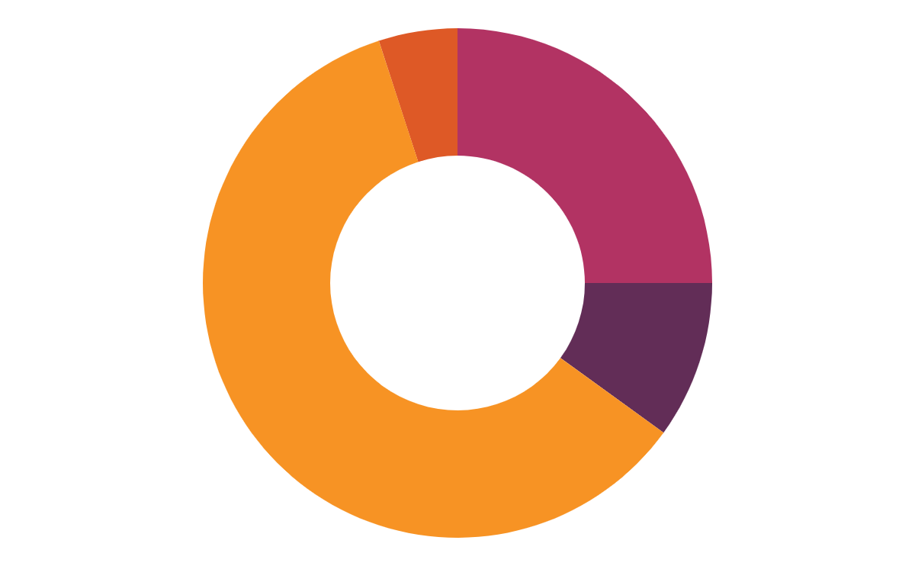
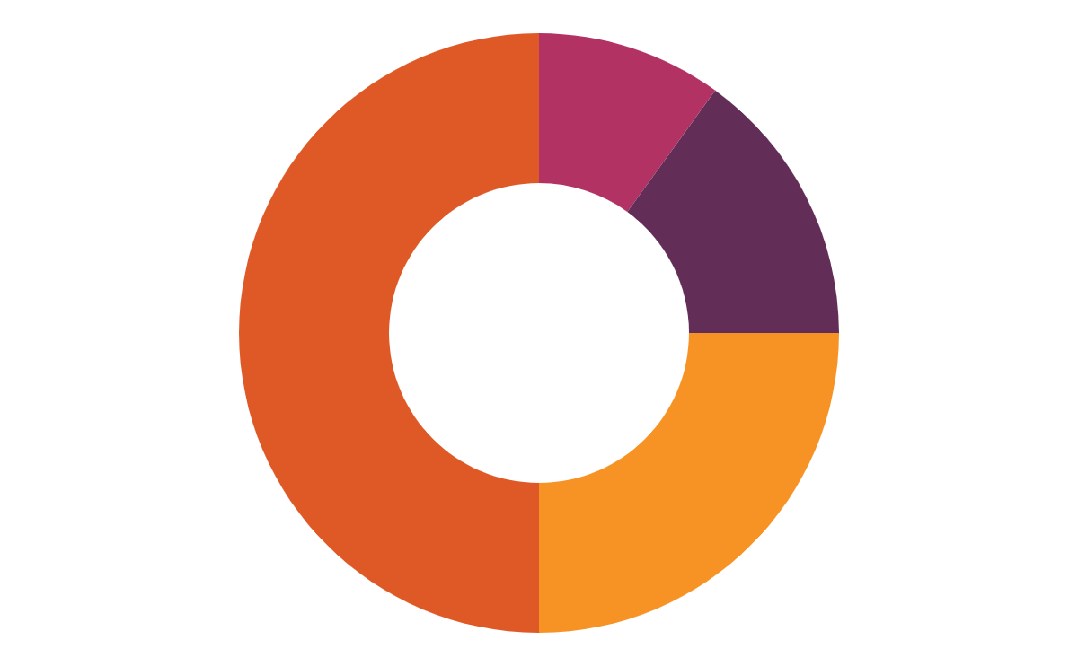
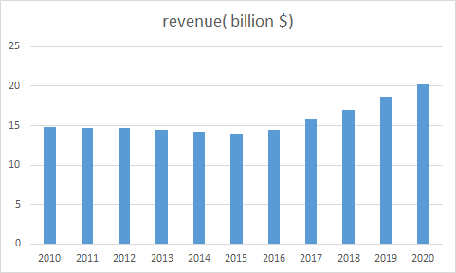
Industry Analysis
Percentage Share of Revenue Sources
Revenue over the past 5 years
2010
2020
Physical
Downloads
Streaming
Performing Rights
Notes:
Music is one of the most popular types of online source of entertainment and the importance of the music industry can be expressed in its total revenues. For 2020 they were US$20.1 billion, the industry shows a very promising growth curve too. Technological advancements have seen the rise of streaming services. Streaming services such as Spotify, YouTube Music etc. have a huge impact on the revenue of the music industry.

Slide 5
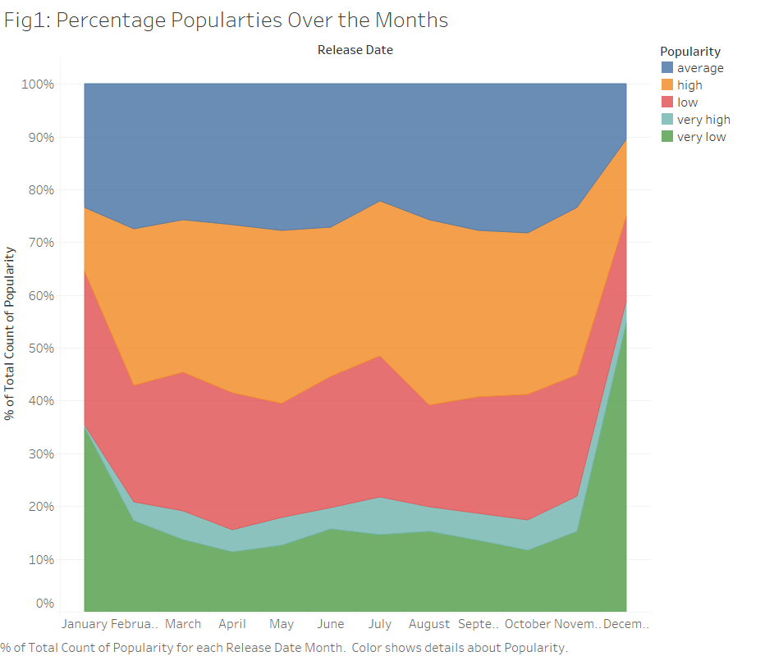
DATA DESCRIPTION
Figure explains the relationship of popularity with the month it was released in. The plot gives us two important inferences firstly the hike in the percentage of very low popularity in the months on January and December and secondly smaller area of the very high popularity indicator suggesting imbalance in the dataset.
Notes:
The first figure explains an average trend of song popularity over the different months. Song released in december are generally more probable for not getting a good response.Also,a very small share of data informs us about very popular songs,hence while modelling we look at oversampling techniques

Slide 6
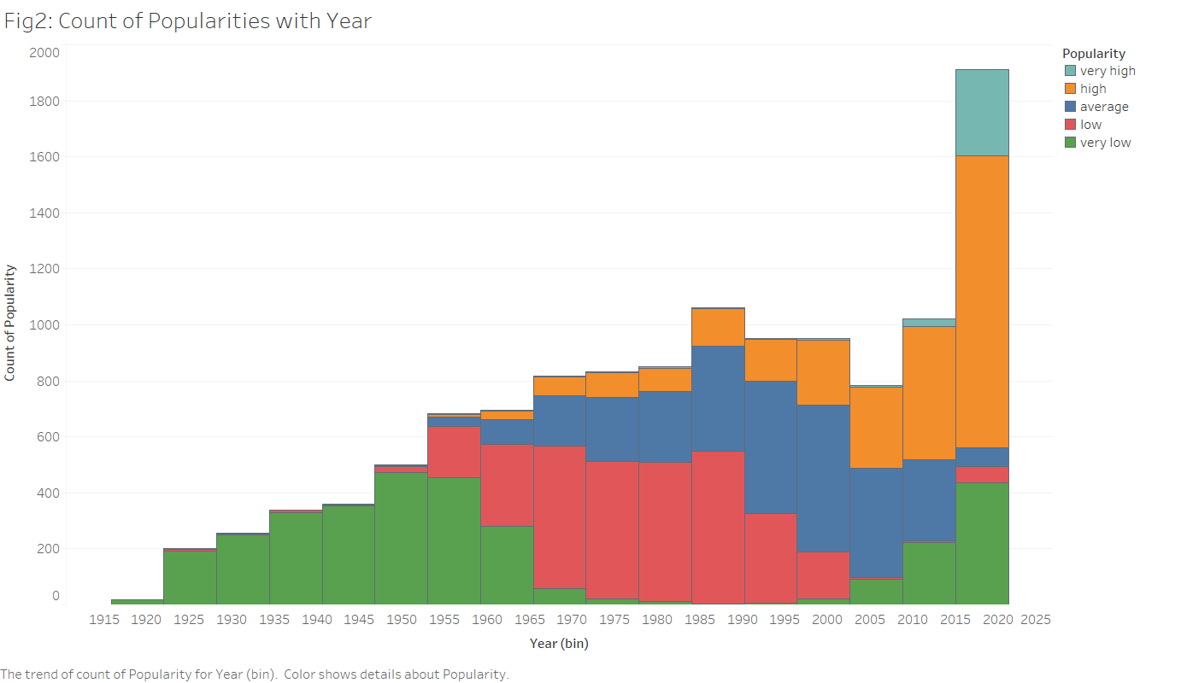
Time Popularity Relation
In the figure, year of release has a major correlation with popularity. The production of the songs in the dataset linearly increases with year ranging from as old as 1920 to as recent as 2021. Evidently, It can be observed from the obtained histogram that songs were lesser popular when produced earlier with normal distribution and as time increases the popularity eventually grows to be exponentially increasing.
Notes:
Through this figure it was observed that quality of songs produced increases linearly with year .Also , the popularity follows normal distribution over the time.The age of the song also affects its popularity.This figure also gives us an indication about how year bins provide critical information for classification.

Slide 7
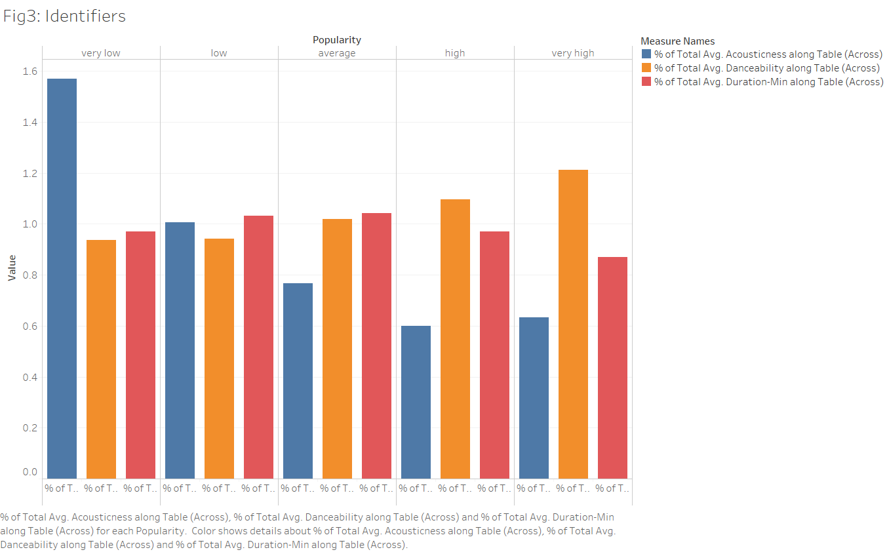
Visualisation
Looking at the figure we can clearly eliminates duration and danceability but it provides evidence for exigent correlation of accousticness with popularity. While most of the data here gives a visual idea about the dataset, the idea that some features together under some heuristic or functional relationship might be able to explain the problem much better. We’ll discuss this and it’s consequences in the feature engineering section.
Notes:
While duration and danceability seems quite important features intuitively but overall not much information can be extracted from them whereas acoustic ness which seems quite irrelevant is actually a good differentiating factor.These also suggest a good deal of electronic music labels being more popular .

Slide 8
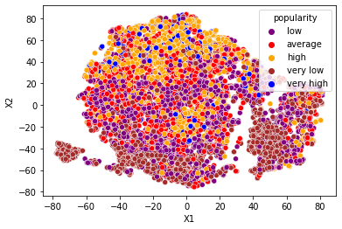
Mapping Higher Dimensions
We try to understand the data in higher dimensions using t-Distributed Stochastic Neighbor Embedding (t-SNE) method. t-SNE is a more probabilistic method than PCA a unsupervised matrix method for explaining variance. Here X1 and X2 are the dimensions of the embedded space based on the original feature space. We can identify clusters for high, very low and low with certain distinction. This also provides us an intuition to use unsupervised techniques for developing new features.
Notes:
T-distributed stochastic neighbor embedding is used to visualize the data probabilistically into two dimensions of embedded space.Some non linear boundaries are possible here.

Slide 9
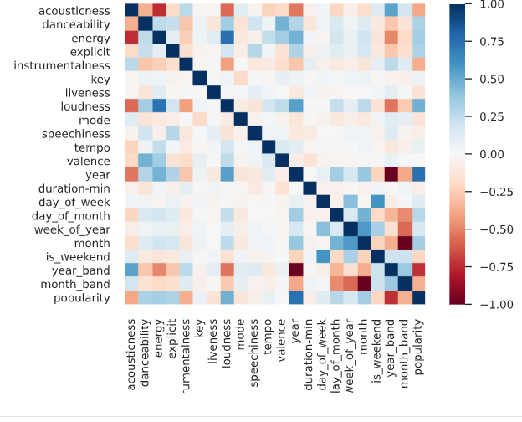
Exploratory Analysis
instr
Notes:
The correlation table provides Pearson’s R coefficient. Uni modulus value of Pearson’s R coefficient signifies more relation between the two variables. A positive correlation refers to the direct proportionality of the variables whereas a negative correlation refers to the inverse proportionality between the same. The correlation table helped establish a measure dependency of all the variables. Rather than just looking over the whole of the correlation table, we focused our attention more on the dependency of popularity over other variables. While analysing the R2 coefficient values in the table, we applied 0.04 thresholding to concentrate more on the more correlated variables beneficial for the prediction of popularity, the target variable. It is evident that there exists a very high positive correlation between the energy and loudness of a song. Variables like date and month, loudness and year, energy and year, danceability and valence also possess a high positive correlation with one another. In specific to popularity variable features like year, loudness, explicit, danceability, energy, date, month possess a positive correlation greater than the threshold. Other features like instrumentalness and acousticness provide a negative correlation to the dependent variable, popularity. Rather than taking all variables as input, selecting an efficient subset from the following provide a better edge on model training.

Slide 10






Feature Description
Highly correlated to popularity.
Year of Release
The production of the songs in the dataset linearly increases with year ranging from as old as 1920 to as recent as 2021. A good point will be to study frequency distribution for the years as shown earlier.
The majority of the songs are produced in the month of January which consists of about 36.277% of the distribution. A trend is seen in date distribution, with the first day of the month being 37.997% probable for producers to release their songs. Other information like date, day, month, week is extracted from the same.
Release Date
Loudness
The distribution of the variable over the dataset is left-skewed. The mean and median of the distribution as -8.49 and -9.82 respectively. A similar shape of the distribution is to be seen within each popularity category, with the median shifting right (increasing) with the popularity of the song.
Energy
Energy feature has a high correlation with the popularity of the song, scaled from 0-1. There is a generalistic positive trend with the loudness and release time span. Energy itself is distributed in the normal distribution. It is observed that songs with lower energy have statistically been less popular.
Acoustic
This music generally uses a lot of instruments to produce sound. It has a non-linear distribution with songs majorly ranging at extreme ends forming a concave-shaped curve. It has a high negative correlation with the year
Instrumentalness
It varies on the scale of 0-1, representing the primary use of instruments in the song. On visualizing the dataset it is observed that 28.89% of the dataset have 0 instrumentalness.
Danceability
It provides the measure to determine if the song is preferred by people to dance and groove on. The dataset consists of the Gaussian distribution of danceability in songs
Notes:
The release date information is vital for the prediction of popularity. The majority of the songs are produced in the month of January which consists of about 36.277% of the distribution. While the high popularity songs are uniformly distributed, the lesser ones are centric to the month of January. A much similar trend is seen in date distribution, with the first day of the month being 37.997% probable for producers to release their songs. Other information like date, day, month, week is extracted from the same.
Year of release has a major correlation with popularity. The production of the songs in the dataset linearly increases with year ranging from as old as 1920 to as recent as 2021. Evidently, It can be observed from the obtained visual plots that songs were lesser popular when produced earlier with normal distribution and as time increases the popularity eventually grows to be exponentially increasing.
Loudness is the measure of how loud or sharp the song is, the standard measuring unit is of dB. The distribution of the variable over the dataset is left-skewed. The mean and median of the distribution as -8.49 and -9.82 respectively. A similar shape of the distribution is to be seen within each popularity category, with the median shifting right (increasing) with the popularity of the song.
Acoustic music is one that primarily uses instruments that produce sound through acoustic means, as opposed to electric or electronic means. It has a non-linear distribution with songs majorly ranging at extreme ends forming a concave-shaped curve. It has a high negative correlation with the year. Acoustic music can be much related to songs that are soft, negatively correlated with loudness.
Instrumentalness, similar to acousticness, it varies on the scale of 0-1, representing the primary use of instruments in the song. On visualizing the dataset it is observed that 28.89% of the dataset have 0 instrumentalness. However, the songs with an instrumentalness value greater than 0.5, are mostly categorized with lower popularity. With the increase in popularity, there is a centric behaviour of the instrumentalness to confine with a value approximate to 0.
Explicit is a categorical feature having classes of No and Yes, which are label encoded as 1-2 respectively. By applying the SMOTE method it generated explicit values for the minority category (very high popularity) which varied between 1-2. Thus thresholding of 0.5 was applied to convert the continuous variable to a categorical one. With the varied distribution in the popularity category, it can be statistically seen that with the increase in the popularity of the song more and more songs are been built as Yes explicit from 5.2% to 38.08%. However No explicit category taking much of the distribution of overall as well as categorical popularity subsets.
Danceability, scaled from 0-1, provides the measure to determine if the song is preferred by people to dance and groove on. The dataset consists of the Gaussian distribution of danceability in songs, which can even be seen among the various categories of popularity. In total there is just a slight shift of the distribution towards the right in terms of popularity. That means that songs that are more danceable tend to get more and more popular.
Energy feature has a high correlation with the popularity of the song, scaled from 0-1. There is a generalistic positive trend with the loudness and release time span. Energy itself is distributed in the normal distribution. It is observed that songs with lower energy have statistically been less popular.
Other features containing lesser correlation with popularity can be feature extracted to enhance the relationship between the two and help improve the results as well. Valence on a scale of 0-1, describes the musical positiveness conveyed by a track. Tracks with high valence sound more positive (e.g. happy, cheerful, euphoric), while tracks with low valence sound more negative (e.g. sad, depressed, angry). It can be inferred that songs are not popularized due to the positive or negative valence but due to the other factors contributing much more to the same. Features like liveness, speechiness tend to have a skewed right distribution not just in the dataset but in categorical popularity distribution as well. Tempo variable is normally distributed like danceability of the song with outliers near 0. The feature key has hardly any significance in the prediction of the popularity of a song. Lastly, in general, the mode of the song was labelled as 1-2, representing Major, Minor respectively,, where the majority of the songs were distributed in 1.

Slide 11
OTHER FEATURES
valance
liveness
speechiness
tempo
key
mode
Scale:0-1, describes musical positiveness conveyed by track
Skewed towards right, insignificant information gain
Skewed towards right in frequency and popularity distribution
Normally distributed with some outliers near 0
Highly insignificant feature for the model
Represents Major or Minor mode in a song
Notes:
The release date information is vital for the prediction of popularity. The majority of the songs are produced in the month of January which consists of about 36.277% of the distribution. While the high popularity songs are uniformly distributed, the lesser ones are centric to the month of January. A much similar trend is seen in date distribution, with the first day of the month being 37.997% probable for producers to release their songs. Other information like date, day, month, week is extracted from the same.
Year of release has a major correlation with popularity. The production of the songs in the dataset linearly increases with year ranging from as old as 1920 to as recent as 2021. Evidently, It can be observed from the obtained visual plots that songs were lesser popular when produced earlier with normal distribution and as time increases the popularity eventually grows to be exponentially increasing.
Loudness is the measure of how loud or sharp the song is, the standard measuring unit is of dB. The distribution of the variable over the dataset is left-skewed. The mean and median of the distribution as -8.49 and -9.82 respectively. A similar shape of the distribution is to be seen within each popularity category, with the median shifting right (increasing) with the popularity of the song.
Acoustic music is one that primarily uses instruments that produce sound through acoustic means, as opposed to electric or electronic means. It has a non-linear distribution with songs majorly ranging at extreme ends forming a concave-shaped curve. It has a high negative correlation with the year. Acoustic music can be much related to songs that are soft, negatively correlated with loudness.
Instrumentalness, similar to acousticness, it varies on the scale of 0-1, representing the primary use of instruments in the song. On visualizing the dataset it is observed that 28.89% of the dataset have 0 instrumentalness. However, the songs with an instrumentalness value greater than 0.5, are mostly categorized with lower popularity. With the increase in popularity, there is a centric behaviour of the instrumentalness to confine with a value approximate to 0.
Explicit is a categorical feature having classes of No and Yes, which are label encoded as 1-2 respectively. By applying the SMOTE method it generated explicit values for the minority category (very high popularity) which varied between 1-2. Thus thresholding of 0.5 was applied to convert the continuous variable to a categorical one. With the varied distribution in the popularity category, it can be statistically seen that with the increase in the popularity of the song more and more songs are been built as Yes explicit from 5.2% to 38.08%. However No explicit category taking much of the distribution of overall as well as categorical popularity subsets.
Danceability, scaled from 0-1, provides the measure to determine if the song is preferred by people to dance and groove on. The dataset consists of the Gaussian distribution of danceability in songs, which can even be seen among the various categories of popularity. In total there is just a slight shift of the distribution towards the right in terms of popularity. That means that songs that are more danceable tend to get more and more popular.
Energy feature has a high correlation with the popularity of the song, scaled from 0-1. There is a generalistic positive trend with the loudness and release time span. Energy itself is distributed in the normal distribution. It is observed that songs with lower energy have statistically been less popular.
Other features containing lesser correlation with popularity can be feature extracted to enhance the relationship between the two and help improve the results as well. Valence on a scale of 0-1, describes the musical positiveness conveyed by a track. Tracks with high valence sound more positive (e.g. happy, cheerful, euphoric), while tracks with low valence sound more negative (e.g. sad, depressed, angry). It can be inferred that songs are not popularized due to the positive or negative valence but due to the other factors contributing much more to the same. Features like liveness, speechiness tend to have a skewed right distribution not just in the dataset but in categorical popularity distribution as well. Tempo variable is normally distributed like danceability of the song with outliers near 0. The feature key has hardly any significance in the prediction of the popularity of a song. Lastly, in general, the mode of the song was labelled as 1-2, representing Major, Minor respectively,, where the majority of the songs were distributed in 1.

Slide 12
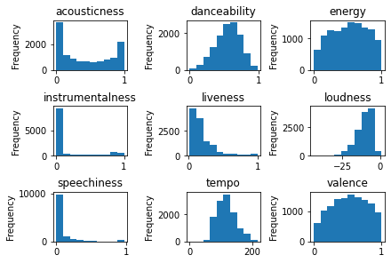
The collaged frequency distribution plot below shows that most of the numeric features aren’t normally distributed. . Energy and danceability are however distributed normally. The duration of a song is normally distributed in the dataset excluding the outliers. It is distinctly observed that the high popularity of music is much concise in the interval near 3-4 mins duration

Slide 13
DATA PREPROCESSING
Label Encoding of Categorical Features
Derived Features
Novel Features
Feature Transformations

Slide 14
Deriving Features
month
week_of_year
Integer [1-12] representing the month of the year
Integer [1-52] for the location of the week w.r.t the year
year
day_of_month
is_weekend
Integer representing the year of release
Integer [1-31] representing the day of the month
Boolean which is True if the day is a weekend

Slide 15
min-1930
Country
1930-1940
Jazz
Year band Feature
1940-1950
Jazz and R&B
1950-1960
04
Rock and Roll
It was globally observed that rather than using individual year we could group a decade into a year band, to provide better correlations.
1960-1970
03
Soul, Pop-Rock
1970-1980
Pop-Rock
1980-2000
02
House
2000-2011
01
Rap/Punk
2011-2020
Rap/EDM
2020+
EDM

Slide 16
Month Band
March
April
Feel good, light, positive messages
Songs about money
January/ February
Workout songs
Positive messages
May
Celebration & summer fun
August
June/July
Upbeat, energetic
September/October/November/December
good month for new releases as well.

Slide 17
DATA PREPROCESSING: Transformations
loudness
Binning w.r.t standard deviations from mean + logarithmic scaling
energy
Logarithmic scaling -> 6.13% increase in correlation
accousticness
Exponential scaling -> 5% increase in correlation
danceability
Logarithmic scaling -> skewed to balanced normal distribution
speechiness
Exponential scaling -> 6.45% increase in correlation
valence
Exponentially scaling -> 4.53% increase in correlation
instrumentalness
Logarithmic scaling -> skewed to balanced normal distribution
duration
Binning w.r.t time stamps + logarithmic scaling
Notes:
Transformations
“loudness”: Binning w.r.t distance of multiples of standard deviations from mean, followed by logarithmic scaling to normalize the distribution.
“accousticness”: Exponential scaling of the feature giving a 5% increase in correlation.
“speechiness”: Exponential scaling of the feature giving a 6.45% increase in correlation.
“instrumentalness”: Logarithmic scaling there was transformation of skewed to normal distribution in various categories of popularity.
“energy”: Logarithmically scaled giving a 6.13% increase in correlation.
“valence”: Exponentially scaled which substantially improved the dependency.
“danceability”: Exponentially scaled due to the skewed distribution.
“duration-min”: Binned into categories depending on various time stamps, followed by a logarithmic scaling to convert the skewed distribution to a normal distribution.

Slide 18
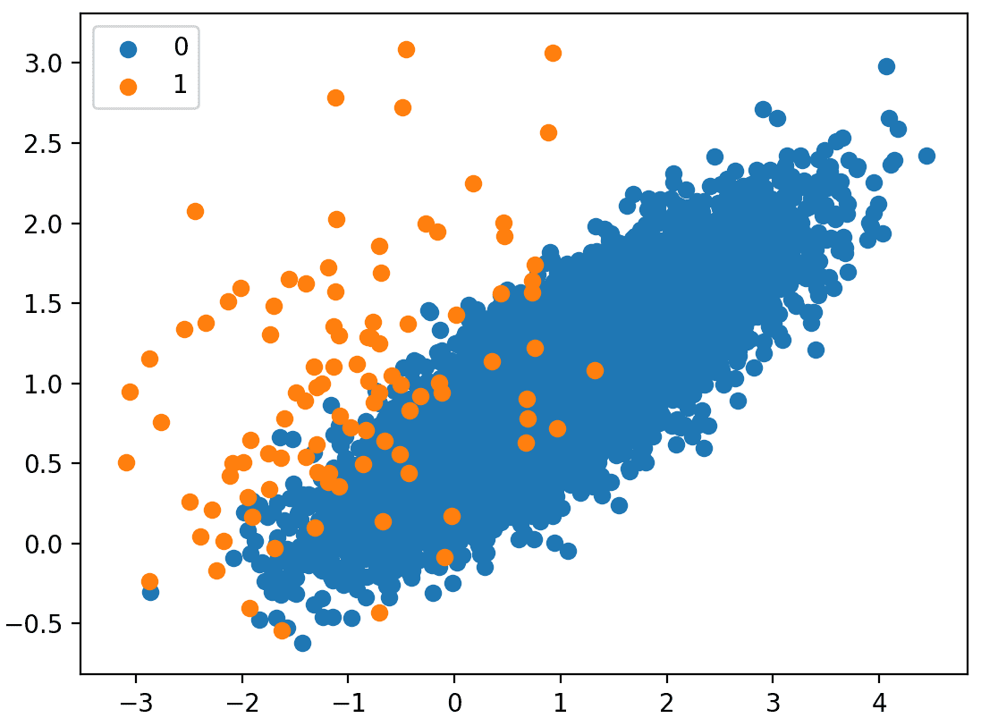
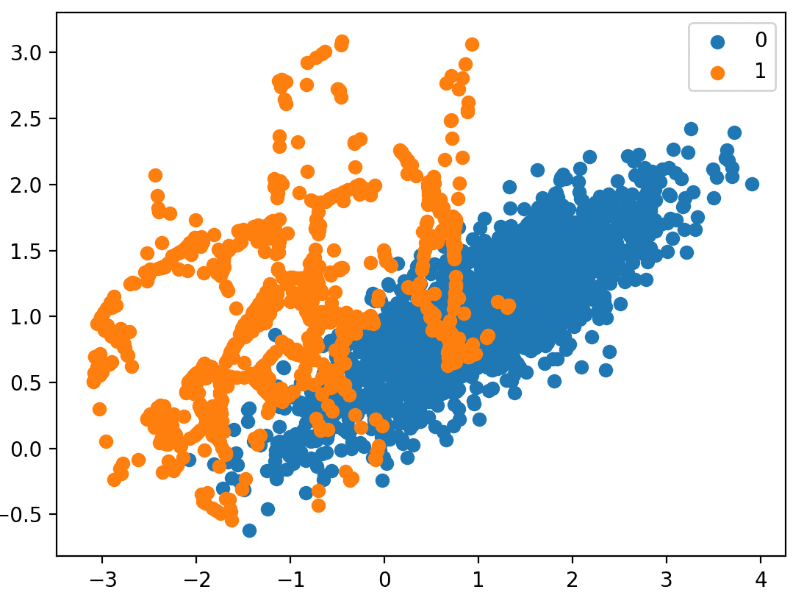
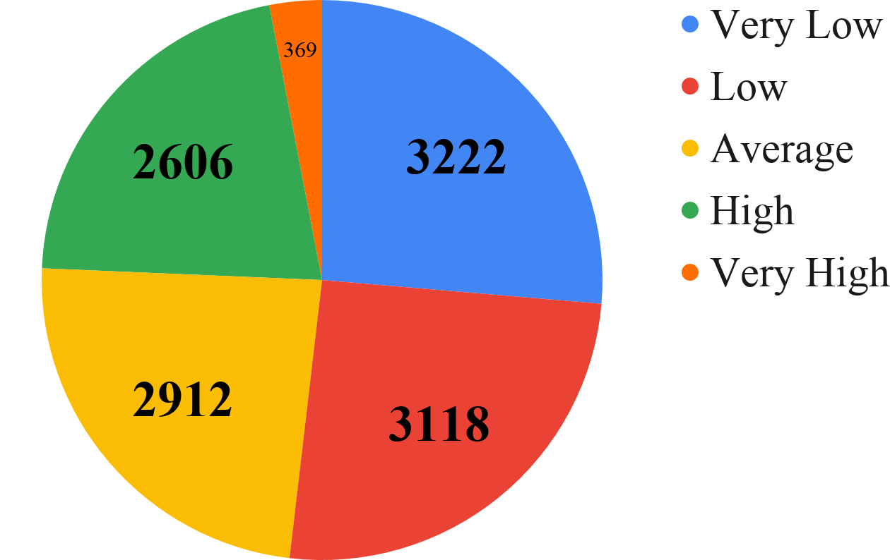
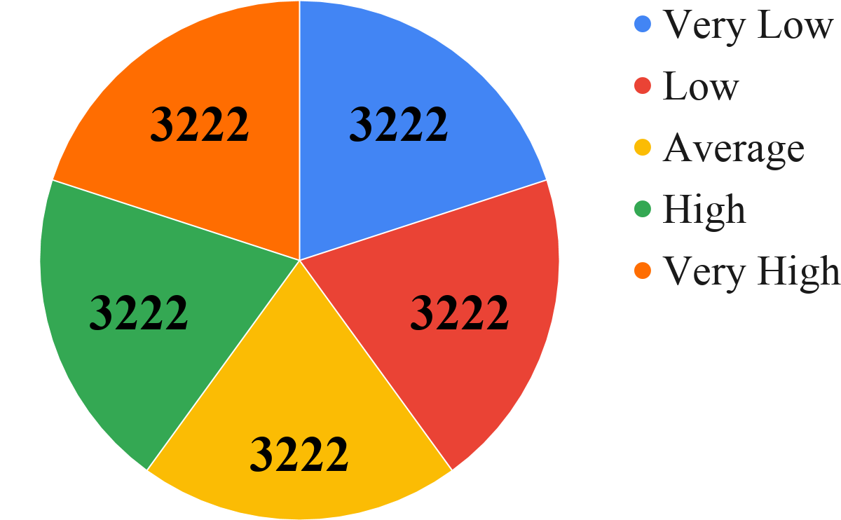
DATA PREPROCESSING: SMOTE
How SMOTE works
Effect of using SMOTE

Slide 19
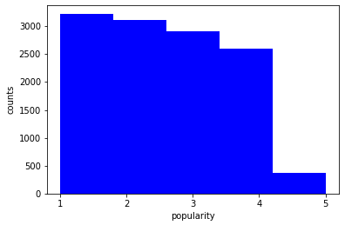
Synthetic Minority Oversampling Technique (SMOTE)
The basic idea of SMOTE is to oversample the minority class by generating new samples. Since these samples are “synthetic”, i.e. not observed data points but rather interpolated points from the n-dimensional feature space, hence the name “Synthetic” Minority Oversampling Technique. Using SMOTE we achieve a massive boost in performance, with the F1 score increasing from 0.62 to 0.71 with the Random Forests based classifier.
We used a number of variants of the basic SMOTE algorithm -
Borderline-SMOTE: A variant of SMOTE that involves selecting those instances of the minority class that are misclassified with a k-nearest neighbor classification model. The points on a decision boundary in the feature space are likely to be ambiguous (i.e. can belong to either region sharing the boundary) and are thus more important for classification.
Borderline-SMOTE SVM: This model enjoys the advantages of Borderline SMOTE and also adds a superior Support Vector Machine for the detection of the decision boundary. Due to this, this variant of SMOTE gives the best augmented dataset that is able to achieve an F1 score of 0.72 (which is increased further using other techniques).
Notes:
Hence it’s clearly evident that there is significant imbalance in the dataset, particularly in the “very high” category of popularity. As a result, most machine learning techniques have poor performance on the minority class. To address the same, we used SMOTE.
The basic idea of SMOTE is to oversample the minority class by generating new samples. Since these samples are “synthetic”, i.e. not observed data points but rather interpolated points from the n-dimensional feature space, hence the name “Synthetic” Minority Oversampling Technique. Using SMOTE we achieve a massive boost in performance, with the F1 score increasing from 0.62 to 0.71 with the Random Forests based classifier.
We used a number of variants of the basic SMOTE algorithm -
Borderline-SMOTE -> A variant of SMOTE that involves selecting those instances of the minority class that are misclassified with a k-nearest neighbor classification model. The points on a decision boundary in the feature space are likely to be ambiguous (i.e. can belong to either region sharing the boundary) and are thus more important for classification. Emphasizing the generation here would enable the generation of samples that allow the models to learn the decision boundary better.
Borderline-SMOTE SVM -> an alternative of Borderline-SMOTE where an SVM algorithm is used instead of a KNN to identify misclassified examples on the decision boundary. This model enjoys the advantages of Borderline SMOTE and also adds a superior Support Vector Machine for the detection of the decision boundary. Due to this, this variant of SMOTE gives the best augmented dataset that is able to achieve an F1 score of 0.72 (which is increased further using other techniques).

Slide 20
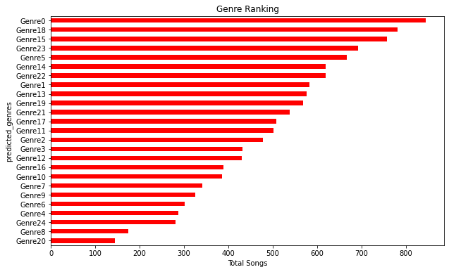
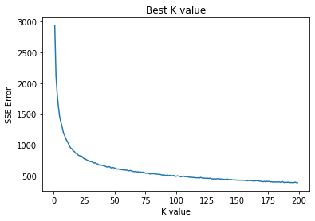
FEATURE GENERATION
While the features given in the dataset are ample to make a predictive pipeline but what could be noted from literature present for music analysis over the year that genre and the artist’s identity itself could give a strong predictive pipeline. Here’s where we use the existing features to develop better ones.
Generating artist’s name based on other features is quite difficult because most artist’s perform different genre. Hence we apply K-means algorithm on numerical features like acousticness, energy, loudness, speechiness, danceability etc. to make clusters which could very well be identified as music genre thereby enhancing classification power. Plotting SSE vs number of clusters indicate an elbow at around K=25. Hence we get 25 genre of music for the dataset. The genre is then added as a feature to the dataset. Refer to annexure

Slide 21
MODEL ARCHITECTURES
Gradient Boosting
05
01
Logistic Regression
CatBoost
MACHINE LEARNING MODELS
Random Forest
06
02
AdaBoost
07
03
XGBoost
Stacking Classifier
08
04
Light GBM
08
Artificial Neural Networks
DEEP LEARNING MODELS
1-D Convolutional Neural Network
01
02

Slide 22
Hyperparameter tuning
It is highly recommended to use continuous distributions for continuous parameters
Random search CV
It helps to loop through predefined hyperparameters and fit your estimator on set.
Grid search Cv
Hyperparameter tuning techniques
It ensure that all possible values of all hyperparameters are considered equally for deep learning models.
Orthogonal Array Tuning Method

Slide 23
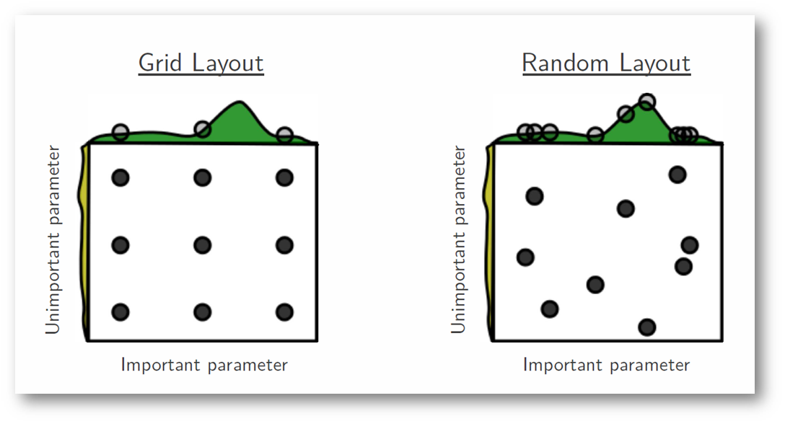
Which Tuning method should be choosed?

Slide 24
As you can see, this search method works best under the assumption that not all hyperparameters are equally important. While this isn't always the case, the assumption holds true for most datasets.
Photo by Bergstra, 2012

Slide 25
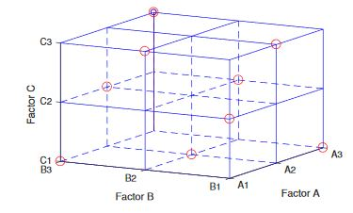
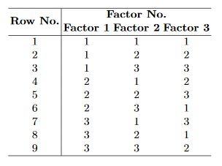
Orthogonal Array Tuning Method
We describe the OATM approach in five detailed steps and elaborate on it using two widely used deep neural network structures (Recurrent Neural Networks and Convolutional Neural Networks).

Slide 26
Process Diagrams Important parameters for tree based models and boosters
The number of trees (or rounds)
01
N_estimator
The deeper you allow it , the more complex your model will become.
Max_depth
02
Using it we can limit up to what depth I want every tree in our model to grow.
03
max_features
It controls how quickly the model is adapted to the problem.
learning_rate
04

Slide 27
Artificial Neural Network Parameters :
Number of hidden layer=3, nodes=8, batch_size=32, epochs=100, optimizer=”Adam”
Convolutional Neural Network Parameters:
Number of hidden layer=6(2+2+1+1), nodes=8, batch_size=32, epochs=100, optimizer=”Adam”

Slide 28
Metric for Analysis of Model Performance
Revenue
F1
This is the custom metric which we built to calculate the total revenue generated by the model after bidding
Accuracy
It is the best way to incorporate both the precision and the recall of the model.
This is the most common metric used to just analyse the model’s performance

Slide 29
Results

Slide 30
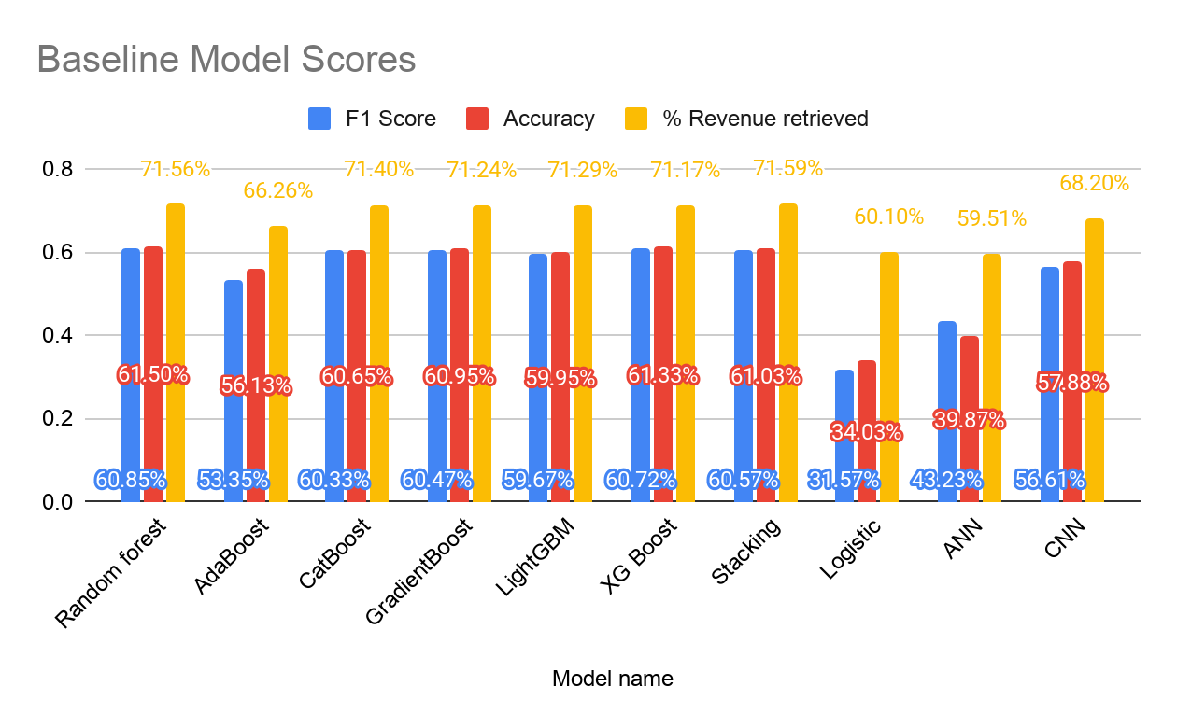
Preliminary Results
Notes:
We should realize that even though the model might perform well in the F1 or the Accuracy metric that does not guarantee that the revenue is maximized. So in order to correctly formulate the custom metric, we used the revenue generated after investing the a total sum of 10000$ on 4000 validation music stocks. We purposely made a train-val split such the validation dataset has exactly 4000 music albums to bid for. All the predictions of the model for the validation set is used to calculate the revenue generated by the model. We also use a constant seed number so that the test split remains the same on every run. This is required when we calculate the maximum possible revenue the model can generate. We calculated that if the test set has 4000 music albums to be generated then based on the popularity of the albums the maximum possible revenue is 22013$. This means that if our model has 100% accuracy then the revenue generated by the model is 22013$. Since it is difficult to maximize the accuracy we instead maximize the revenue directly by adjusting the loss function. In this way we train the model to atleast give a positive profit rather than zero or negative ones. After using the revenue as the main metric function and the custom loss function instead of the normally used loss function. Our revenue before any preprocessing and custom loss was around 15753$. After doing the preprocessing and using custom loss function we got a boost in revenue to 19352$ and the F1 score is around 0.7229. So although our accuracy of prediction on the validation set is around 73% the percentage of revenue generated is close to 88 %.

Slide 31
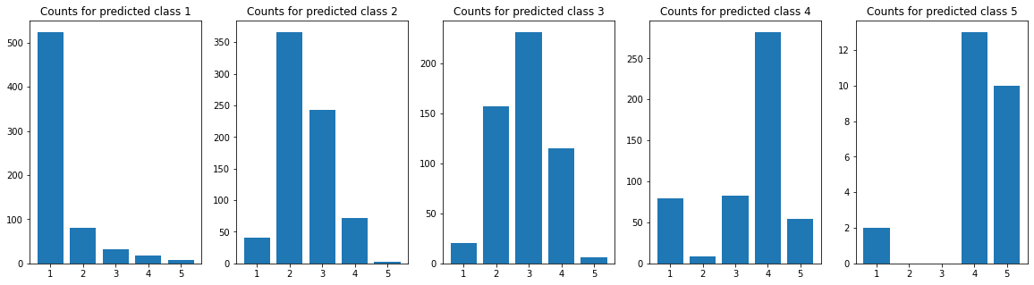
ERROR ANALYSIS

Slide 32
CUSTOM LOSS FUNCTION TO MAXIMIZE REVENUE
The custom loss has been designed to capture various different scenarios in model training or tuning hyperparameters. These scenarios are derived with respect to the relationship between the predicted and the actual bid.
Actual: 1
Actual: 3
Actual:
3
Actual: 5
Actual: 3
Predicted:
3
Predicted:5
Predicted:4
Predicted:
3
Loss: 4
Predicted: 2
Loss: 1
Loss: 3
Loss: 5
Loss: 0

Slide 33
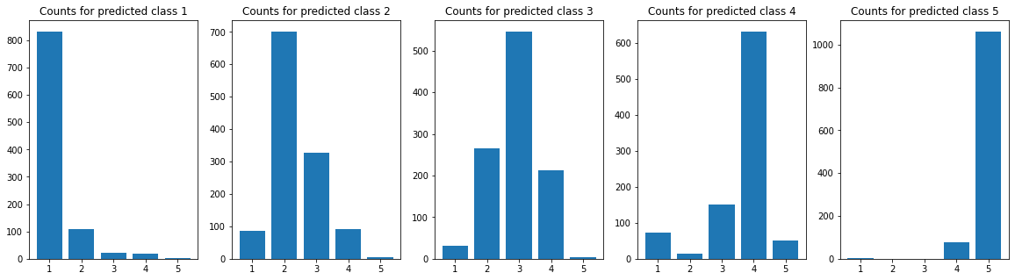
ERROR ANALYSIS AFTER CUSTOM LOSS AND FEATURE ENGINEERING

Slide 34
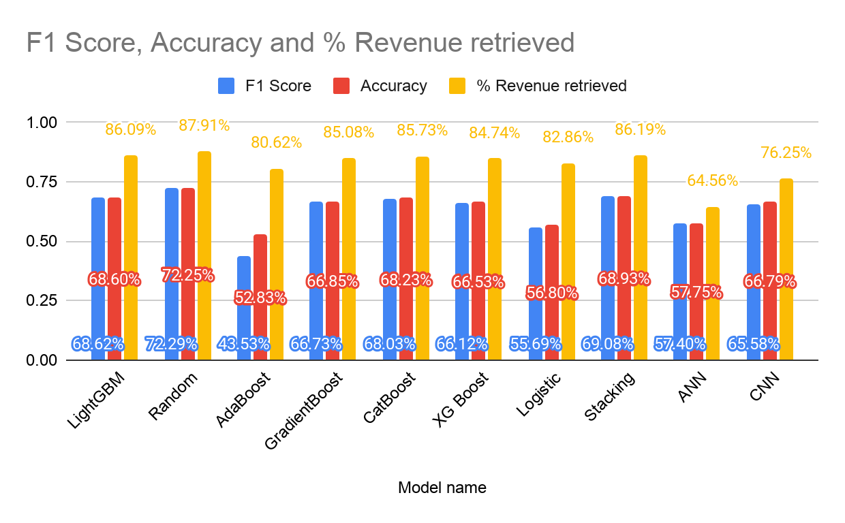
Final Results
Notes:
We should realize that even though the model might perform well in the F1 or the Accuracy metric that does not guarantee that the revenue is maximized. So in order to correctly formulate the custom metric, we used the revenue generated after investing the a total sum of 10000$ on 4000 validation music stocks. We purposely made a train-val split such the validation dataset has exactly 4000 music albums to bid for. All the predictions of the model for the validation set is used to calculate the revenue generated by the model. We also use a constant seed number so that the test split remains the same on every run. This is required when we calculate the maximum possible revenue the model can generate. We calculated that if the test set has 4000 music albums to be generated then based on the popularity of the albums the maximum possible revenue is 22013$. This means that if our model has 100% accuracy then the revenue generated by the model is 22013$. Since it is difficult to maximize the accuracy we instead maximize the revenue directly by adjusting the loss function. In this way we train the model to atleast give a positive profit rather than zero or negative ones. After using the revenue as the main metric function and the custom loss function instead of the normally used loss function. Our revenue before any preprocessing and custom loss was around 15753$. After doing the preprocessing and using custom loss function we got a boost in revenue to 19352$ and the F1 score is around 0.7229. So although our accuracy of prediction on the validation set is around 73% the percentage of revenue generated is close to 88 %.

Slide 35
Conclusion
We have generated a model that is able to generate a revenue of
$19352
Out of Maximum Possible Revenue of
$22013
Which is about
88%

